Slide 1
POWER
Meaning, Sources, and Contingencies of Power, Consequences of Power.

Slide 2
Meaning:
Power is the capacity of a person, team, or organization to influence others. Power is not the act of changing someone’s attitudes or behavior; it is only the potential to do so.
Power refers to that control or holds over another person, organization or body of people.
The more power you have, the more responsible you must be with it.

Slide 3
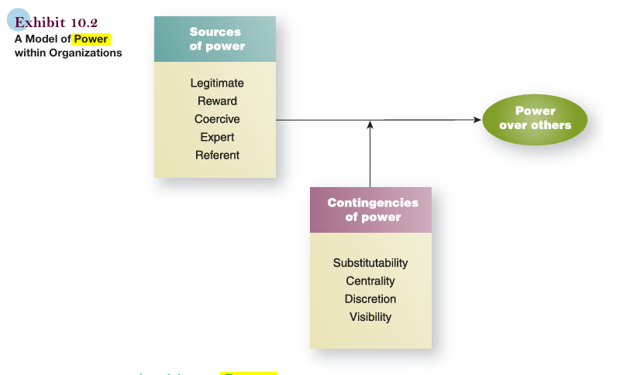
Sources and Contingencies of Power

Slide 4
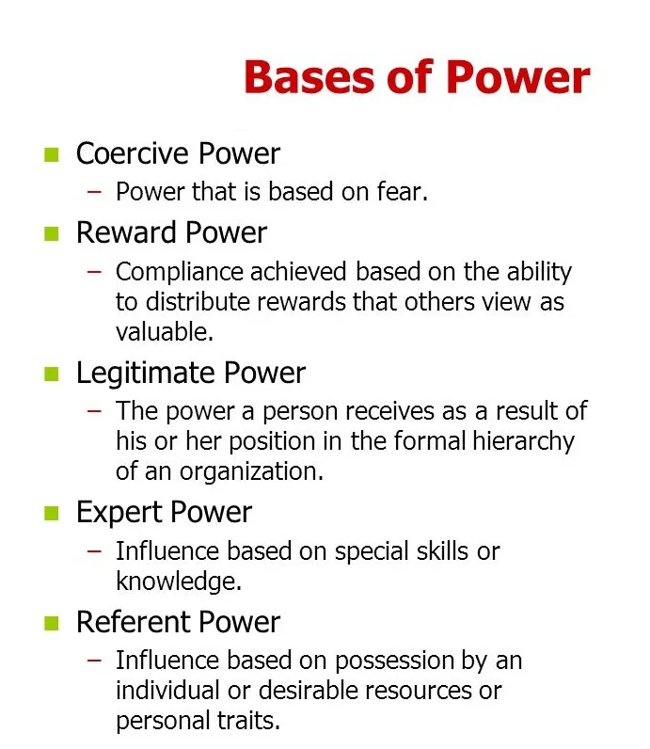

Slide 5
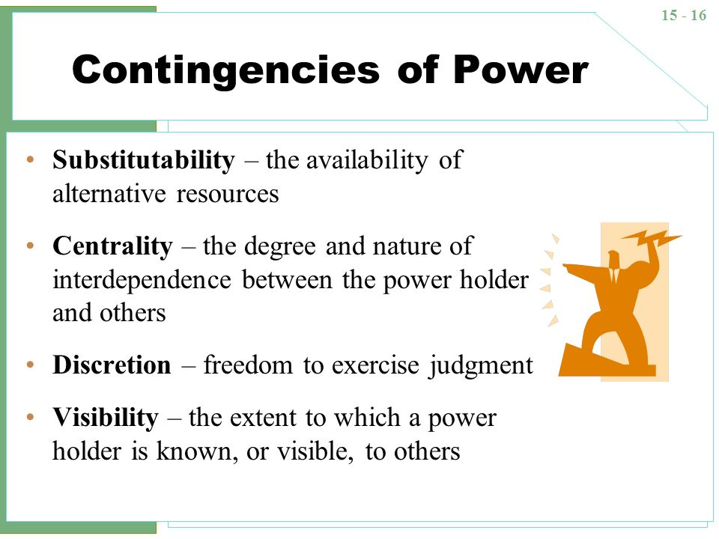

Slide 6
Consequences of Power
The unequal power in organizational behaviour refers to the imbalance of authority, control, or influence between two or more parties within an organization.
There are three consequences of unequal power:
1. Compliance.
2. Commitment.
3. Resistance.

